Slide 1

Test Launch Results

Slide 2
We have recently completed the test launch of our tabletop menu tablets at two of our pilot locations. We achieved this milestone together as a team through efforts started about a month a half ago and included various tasks such as:
Procuring the tablets based on technical requirements
Coordinating with internal teams, such as marketing and our head chef Carter
Developing and training the staff at both locations
Summary

Slide 3
The team was aiming to measure customer satisfaction, functionality of tablets, improvement in customer service, and efficiency of the new system. We accomplished this through a variety of modalities including customer surveys, metrics, and observation.
Overview

Slide 4
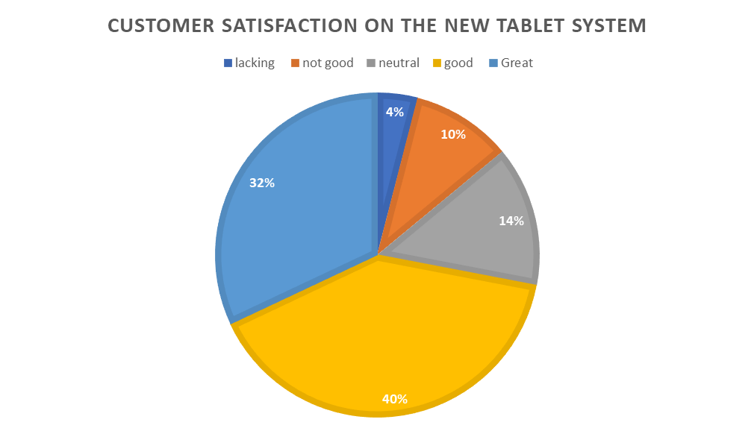
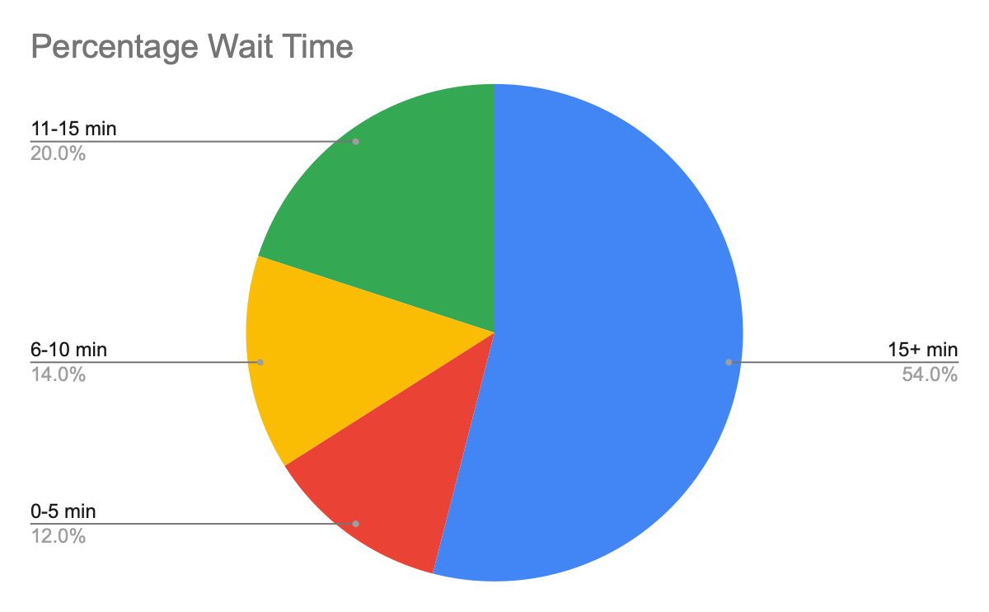
Findings

Slide 5
Identify and improve the reasons why our customers are having to wait over 15 minutes to be seated. This can be investigated by analyzing existing table turn times and see what other improvements can be made in this area.
We found some customers were having issues with the interface and UX of the tablet itself, so this might mean some follow-up with marketing regarding the design or providing feedback to the vendor to improve the software of the tablets.
Next Steps

Slide 6
Review the training:
with the members of the kitchen (28% of customers did not receive the correct order)
the members of the room (24% of customers were not satisfied with the explanations)
provide an explanatory sheet
Contact the tablet vendor:
for technical problems: the screen has frozen.
for kitchen controls: check if the feature is working properly when requesting changes
Next Steps

